Slide 1

Algorithms and Compression Techniques For Genome Sequencing
Department of Electrical Engineering, IIT Hyderabad
under the guidance of
Dr. Shashank Vatedka
Assistant Professor
Department of Electrical Engineering
Indian Institute of Technology, Hyderabad
Kandi, Sangareddy, Telengana 502285

Slide 2
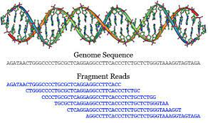
Contents
Introduction
Motivation
Literature Survey
Abstract
Sequencing DNA
FASTQ read
Read Alignment Problem
Naive Exact Matching
Boyer-Moore Algorithm
Preprocessing
Indexing and k-Mer
Conclusion

Slide 3
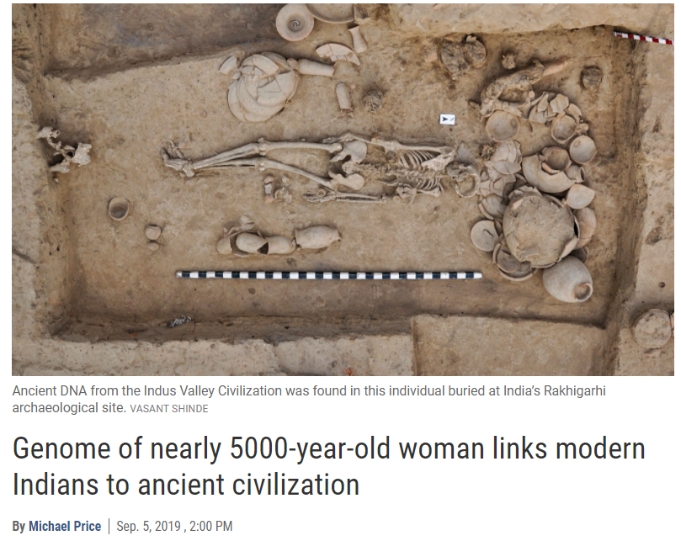
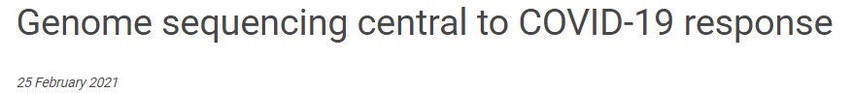
Introduction
DNA Sequencing has become so inexpensive and so good at delivering a lot of data very quickly that sequencers are being used all over the field of life sciences.
Scientists are applying and refining new ways of sequencing to study people’s genomes.
These study answer some of the most fundamental questions about evolutions,patterns of migration, ancient civilizations etc.
Notes:
DNA Sequencing has become so inexpensive and so good at delivering a lot of data very quickly that sequencers are being used all over the field of life sciences.
Scientists are applying and refining new ways of sequencing to study people’s genomes.
These study answer some fundamental questions about evolutions,patterns of migration, ancient civilizations etc.

Slide 4
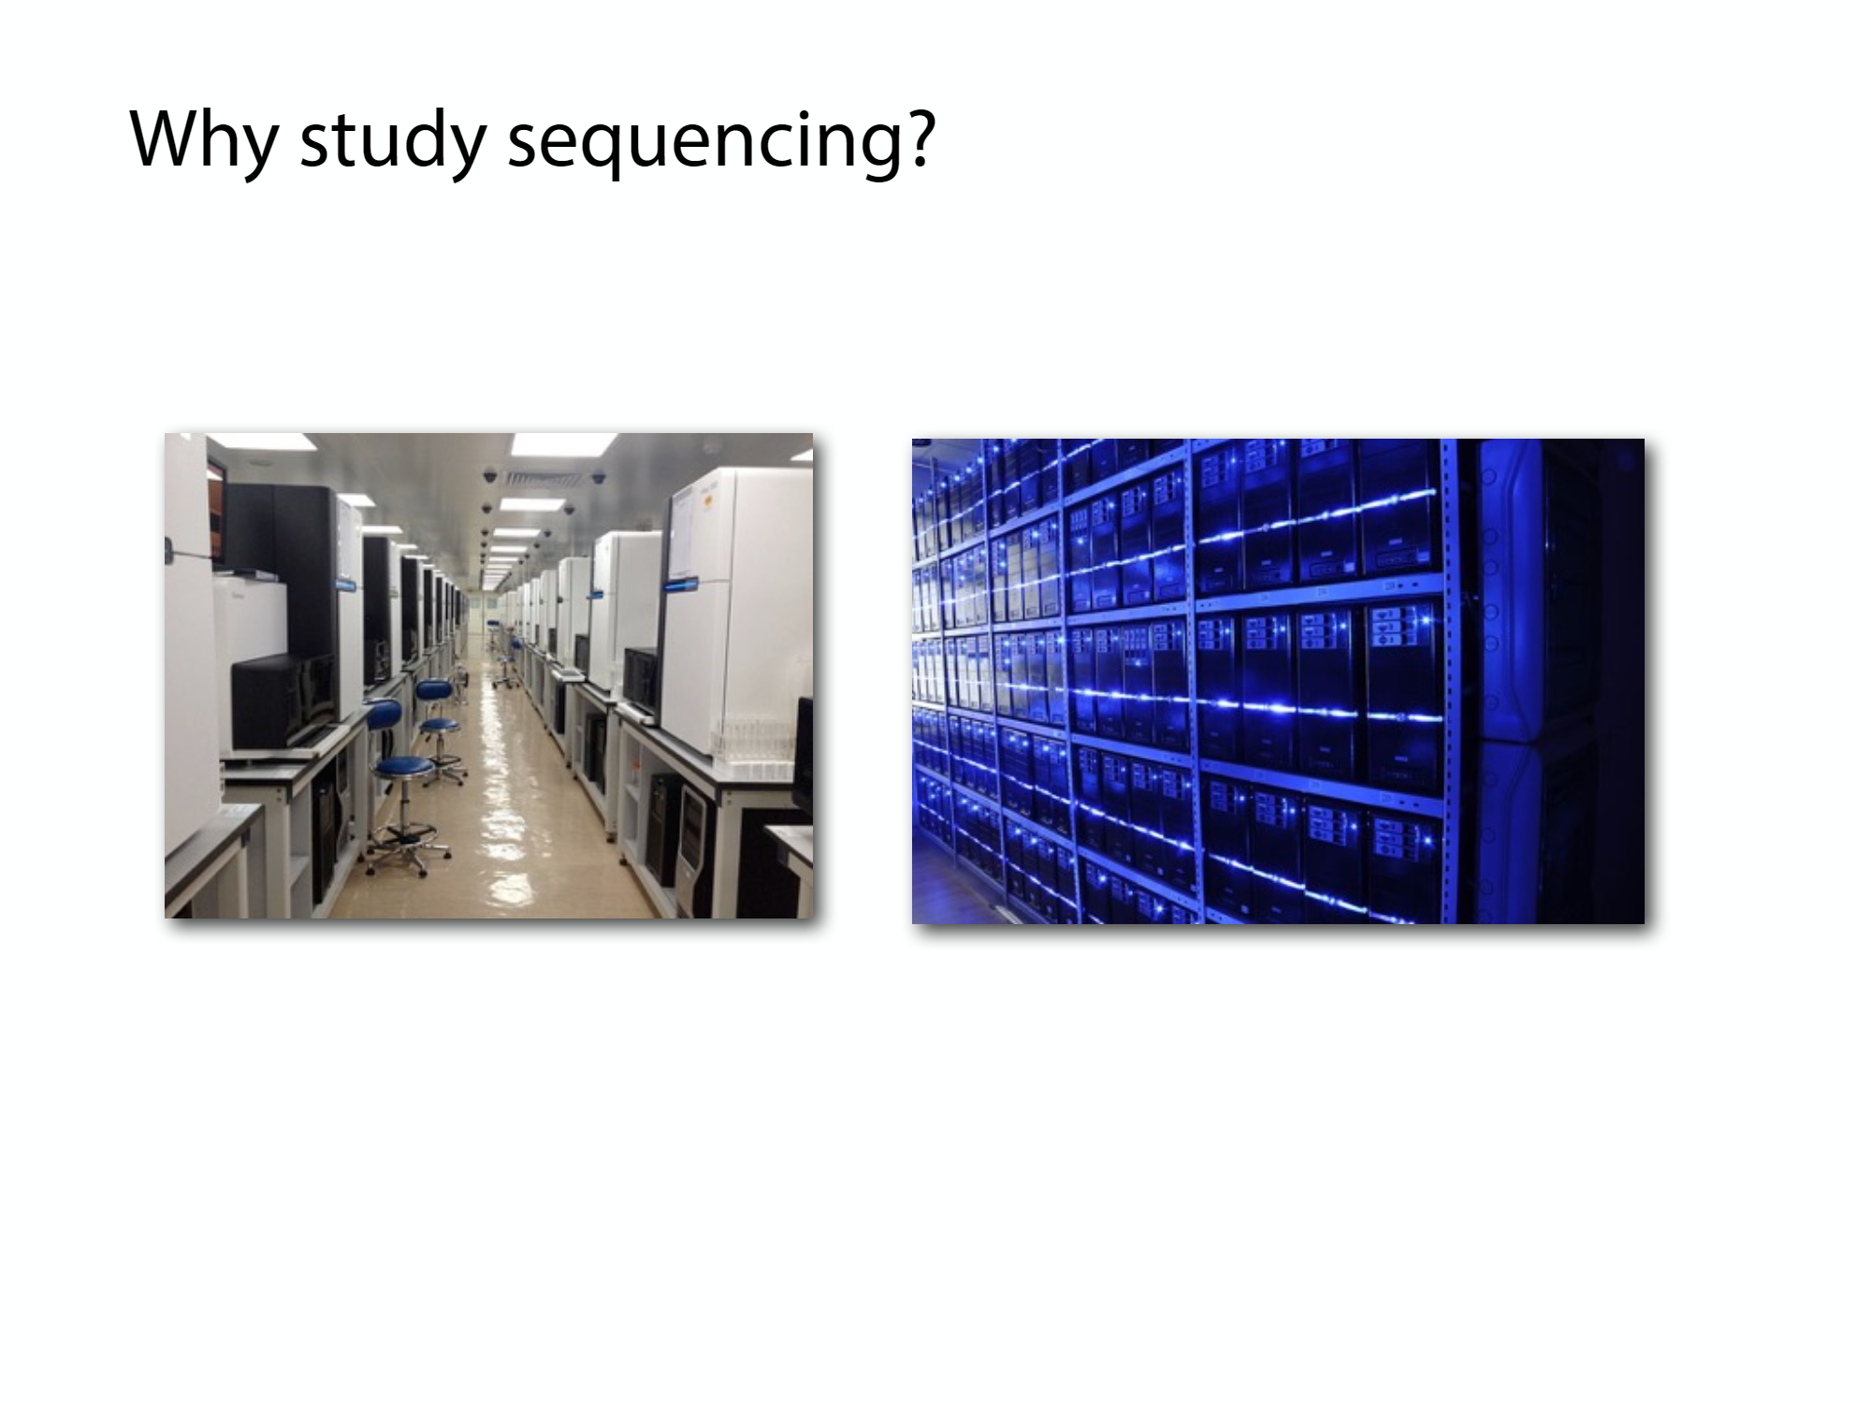
Motivation
Since the introduction of the Sanger sequencing technology in 1977 by Sanger , we got explosion of sequence data. The cost of storage, processing, and analyzing the data is getting excessively high. As a result, it is extremely important that we develop efficient data compression and data reduction techniques.
Understanding computational genomic algorithms is key to understanding where they will succeed and where they will fail. For example the de Novo shotgun assembly problem.
This is a very active area of research where scientists from life sciences and computer science field work together.
Notes:
Understanding computational genomic algorithms is key to understanding where they will succeed and where they will fail. For example starting in the late 90s or so there were two parallel efforts to sequence the human genome and these parallel started out using different sets of approaches, each of the team believing that their team were the most practical way to complete the project quickly and a point they disagreed on was the practicality of solving a particular computational problem known as the de novo shotgun assembly problem.
This is a very active area of research where scientists from life sciences and computer science field work together.

Slide 5
Literature Survey
[1] Subrata Saha and Sanguthevar Rajasekaran, "Efficient algorithms for the compression of FASTQ files," 2014 International Conference on Bioinformatics and Biomedicine
[2] Shengyu Lu, Hanping Chen, Lifa Peng,Beizhan Wang,Hongji Wang and Xuize Zhou,"A compression algorithm of fastq file based on distribution characteristics analysis", The 13th International Conference on Computer Science & Education (ICCSE 2018),Columbo, Sri Lanka
[3] Algorithms on Strings,Trees and Sequences, Computer Science and Computational Biology, by Dan Gusfield
[4] Langmead,B., Trapnell,C., Pop,M., and Salzberg,S.L. (2009), “Ultrafast and memory-efficient alignment of short DNA sequences to the human genome”. Genome Biol, 10, R25.

Slide 6
Abstract
Various algorithms for analyzing ,encoding and compressing real DNA sequencing data are studied and implemented in this project. Some of the insights about designing the algorithm were studied from the research paper,“Efficient algorithms for the compression of FASTQ files” and few others are listed under the Literature Survey..
The three main algorithms discussed in these papers are:
RFRC-reads are clustered based on a hashing scheme. Followed by this clustering, a representative string is chosen from each cluster of reads. Compression is independently done for each cluster. In particular, the representative string in any cluster is used as a reference to compress other reads in this cluster.
RFQSC- It compresses quality score sequences by forming clusters of similar sequences.
Here clusters are formed without the employment of hashing. Each sequence in a particular cluster is then compressed with respect to its representative sequence. The representative sequence can be a brand new sequence or one of the quality sequences residing in the cluster.
MDC-Metadata is compressed by detecting the redundant information.
In this paper presentation, we will briefly explain the proposed novel algorithms for encoding and compressing FASTQ files.
Simulation results show that offline algorithms perform better than online algorithms.
Notes:
The exponential growth of high-throughput DNA sequence
data poses great challenges in genomic data storage, retrieval,
and transmission. Compression is a critical tool to address
these challenges, where many methods have been developed
to reduce the storage size of the genomes and sequencing
data (including reads, quality scores, and metadata). In this
article we have proposed an efficient and scalable algorithm
namely FQC to compress FASTQ files. Simulation results
show that our algorithm is indeed effective, efficient, and
competitive with respect to state-of-the-art algorithms existing
in the domain of FASTQ file compression.

Slide 7
How DNA Sequencers Sequence Genome?
Dna sequencers are not good at reading long stretches of DNA.
They are good at reading short stretches of DNA but lots and lots of them at at time.by repeatedly reading randomly selected substrings from the input DNA.
Snippets are called sequencing reads.Their length are very small compared to input DNA.
Input DNA
CCATAGTATATCTCGGCTCTAGGCCCTCATTTTTT
CCATAGTATATCTCGGCTCTAGGCCCTCATTTTTT
CCATAGTATATCTCGGCTCTAGGCCCTCATTTTTT
Cut into snippets
CCATAGTA TATCTCGG CTCTAGGCCCTC ATTTTTT
CCA TAGTATA TATCTCGGCTC TAGGCCC TCATTTTTT
CCATAGT ATATCTCGGC TCTA GGCCC TCATTTTTT

Slide 8
Genome Sequencing READS
Reads:
GTCTGCTCG
GTCATCTAGCTT
CACACCACCAC
Genome: CGTCGGTCATCTAGCTTGGTGTGACCACACACCACACCACCACCACTCTGTGTCTGCTCG
Notes:
Randomly selected snippets of genome is taken at time.

Slide 9
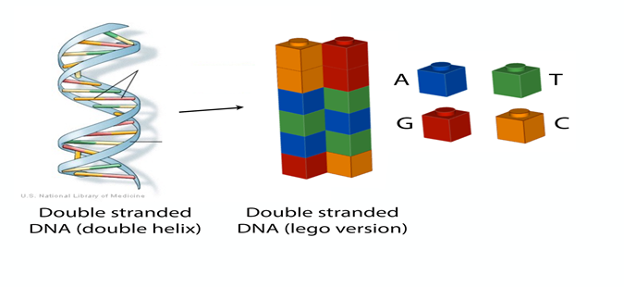
Sequencing DNA
DNA is the kind of molecule that encodes our genome.Genome is the set of chromosomes and it is written in a language that consists of 4 letters - {A,C,G,T}
Notes:
Explain DNA properties.

Slide 10
FASTQ FILE READ
NAME-@ERR266411.1 HS18_09233:8:1307:10911:3848#168/1',
SEQUENCE-'TAAACAAGCAGTAGTAATTCCTGCTTTATCAAGATAATTTTTCGACTCATCAGAAATATCCGAAAGTGTTAACTTCTGCGTCATGGAAGCGATAAAACTC',
IGNORE-'+',
BASE_QUALITY-'B@DFEFFFGEGGGHEHGHGHGGGGHIFGFIFHICFGHGHGJGHFGHGIHEHGGHJGFEFHGHEGGHHGHIFGFGDIFGGFGGGFHGGGHGGGAGIFGGCG',
Sequencing read is encoded in FASTQ format(lines of information)
Name : Metadata information
Sequence : Raw sequence
Base quality : Corresponding base quality of characters to sequence.
Notes:
A READ IN FASTQ FORMAT IS THE FILE FORMAT. NAME-a lines of information about experiment come,kind of sequencing used.
Characters in base quality match up with corresponding characters in sequence line.
Code demo.

Slide 11
Meta data compression
NAME-@ERR266411.1 HS18_09233:8:1307:10911:3848#168/1',
The redundant information is utilised for meta data compression.
Notes:
A READ IN FASTQ FORMAT IS THE FILE FORMAT. NAME-a lines of information about experiment come,kind of sequencing used.
Characters in base quality match up with corresponding characters in sequence line.
Metadata contain unique read/quality sequence identifiers,
name of the platform used, project id, read length, etc. Some
of the information is identical for all the reads and the quality
score sequences such as the name of the platform, project
id and read length. This redundant information is saved only
once. Read/quality score sequence identifiers are typically in
increasing order in the FASTQ file. Hence we have compressed
this information using delta encoding.
Code demo.

Slide 12
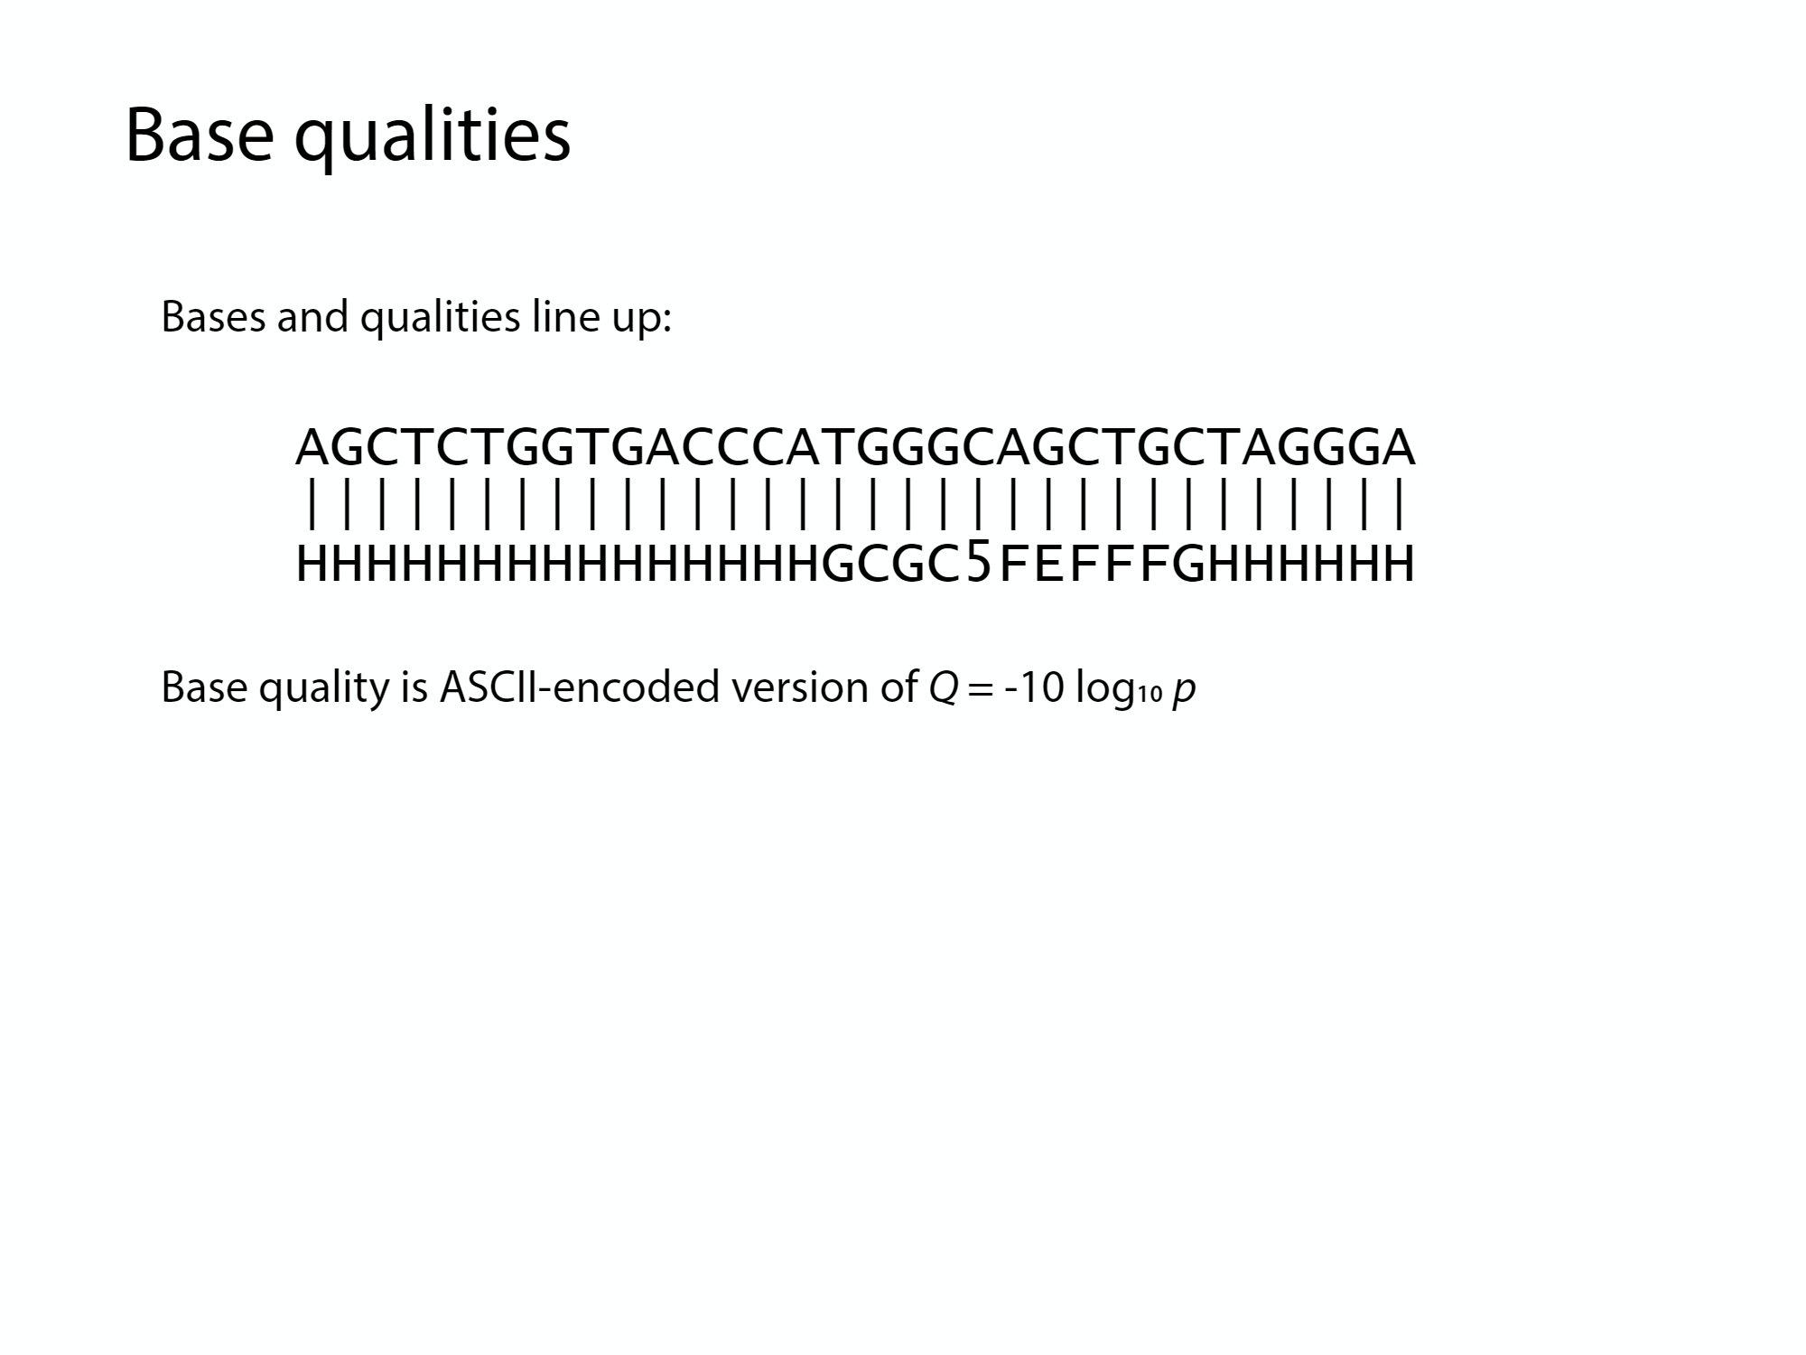
Base Quality Read In FASTQ Format
Example of base quality read:
Characters in base quality match up with corresponding characters in sequence line
Base quality is calculated using this formula
Q = -10 log10(p)
Where ,
Q is base quality
p is probability that the base call is incorrect
Example:
Q = 10 implies 1 in 10 chance call is incorrect
Q = 20 implies 1 in 100 chance call is incorrect
Notes:
Base quality is number, we want to encode them as character.
Base color is software ,it has to deal with ambiguity ,base color will be very confident if all lights coming from cluster is exactly same color,sometimes it is not very confident-all lights coming will be of mix color-measured by bse quality

Slide 13
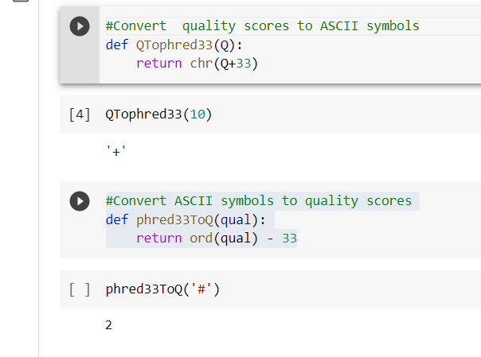
BASE QUALITIES:
Usual ASCII encoding is phred+33
Notes:
Generally,phred33 encoding is used for encoding quality scores to it’s corresponding character
Code demo

Slide 14
Read Alignment Problem
Reading the very long sequence of genome is very challenging.
Even unrelated humans have genome similarity upto 99 percent.
The size of sequencing read is very less compared to overall genome sequencing length.
The read alignment of DNA sequences can be done using 2 methods-
With reference
Without reference
Notes:
,as for example human reference genome is 3 billion bases long.unrelated humans have genomes 99 percent similarity.
Alignment is done using-
1.with reference 2.without reference

Slide 15
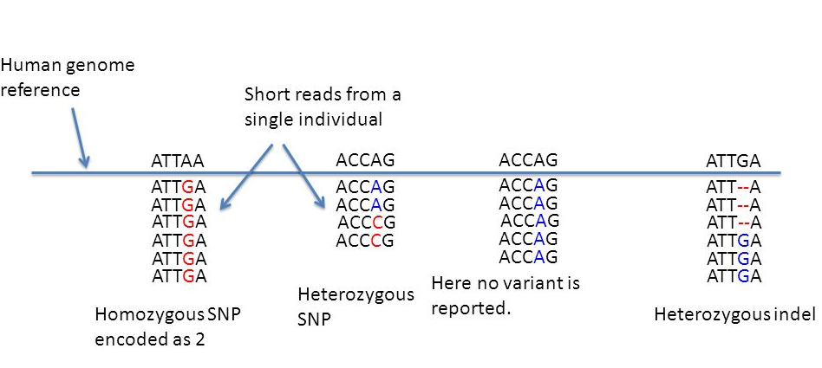
Algorithms for Sequencing Genome Data
Genome sequence can be encoded as a string containing characters from the alphabet {A,G,T,C}.
The ability to write a genome as a string of characters helps in analyzing it using computational methods.
So,sequencing using string is done -data structure algorithms are used.
Naive Exact matching
Boyer Moore algorithm
Notes:
,as for example human reference genome is 3 billion bases long.unrelated humans have genomes 99 percent similarity.
Alignment is done using-
1.with reference 2.without reference
Explain properties of genome strand i.e one is complement of another and code demo.

Slide 16
Naive Exact Matching
Exact Matching is a computational method of matching a pattern P to the text T exactly.

Slide 17
Naive Exact Matching
Exact Matching is a computational method of matching a pattern P to the text T exactly.
For example consider the pattern, text pair given below.
P : word
T : There would have been a time for such a word.
The most straightforward way is to align the pattern P with text T in every possible way and check if in any of these alignments all the characters of P match with corresponding character of T.

Slide 18
Naive Exact Matching
P : word
T : There would have been a time for such a word.
word word word word word word word word word
word word word word word word word word
word word word word word word word word
word word word word word word word word
word word word word word word word word
Notes:
Code Demo

Slide 19
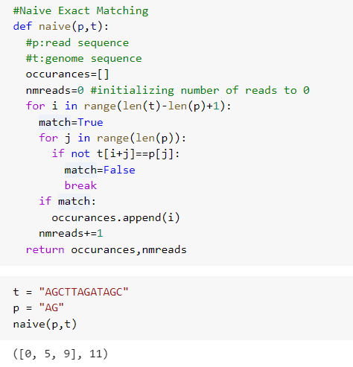
Naive algorithm practical
Notes:
NAIVE IS SIMPLEST ,FLEXIBLE BUT NOT VERY FAST IN FINDING PATTERNS IN TEXT
This slide not required (Paste graph here nmreads)

Slide 20
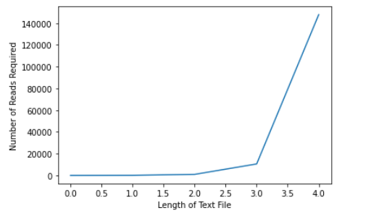
Naive Algorithm Performance
Notes:
NAIVE IS SIMPLEST ,FLEXIBLE BUT NOT VERY FAST IN FINDING PATTERNS IN TEXT
This slide not required (Paste graph here nmreads)

Slide 21
Boyer-Moore Algorithm
Exact matching algorithm : better than naive algorithm, extended version of naive algorithm
Alignments are done from left to right
Characters comparison are done from right to left
For example consider the pattern, text pair given below.
P: ANNU
T: ANKU ANNU STUDY TOGETHER IN SAME CLASS.
In this example,
T: ANKU ANNU STUDY TOGETHER IN SAME CLASS.
P: ANNU
Alignments
Character comparison
Boyer-Moore algorithm does some preprocessing on the pattern P to create lookup tables which are used to implement Bad Character rule, Good Suffix Rule.

Slide 22
Boyer-Moore : Bad Character Rule
Rules are followed as explained in previous slide
When mismatch between characters of text T and pattern P occurs ,skip the alignments till mismatch becomes the match
When there is no possibility for the match for any alignments,let the pattern P to pass over the the mismatched character in text.
Example
case 1:
T: GCTTCTGT CTCGTCACT
P: CCTTTTGT
Result: CCTTTTGT
C will go to T position, skip 3 alignments!
case2:
T: GCTTCTGTAC
P: CCTTTTGC
Result: CCTTTTGC
P moves past mismatched character

Slide 23
Boyer-Moore : Good Suffix Rule
Rules are followed as explained in previous slide
When match between characters of text T and pattern P occurs ,skip the alignments till there are no mismatches between P and T
When there is no possibility for the match for any alignments,let the pattern P to pass over the the mismatched character in text.
Example
case 1:
T: GCTTCTGT CTCGTCACT
P: TGTTTTGT
Result: TGTTTTGT
C will go to T position, skip 3 alignments!
case2:
T: GTCTCTTACTTACTTCATTAC
P: CCTTACTTAC
Result: CCTTACTTAC
P moves past matched character T

Slide 24
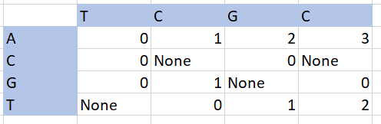
Preprocessing-lookup tables
1.Bad character rule
2.Good suffix rule
Example-bad character rule
T=AATCCTC
P=TCGC, look at row T and column G ,offset of 1 is calculated and it will skip 1 alignment.
Notes:
Preprocessing matrix

Slide 25
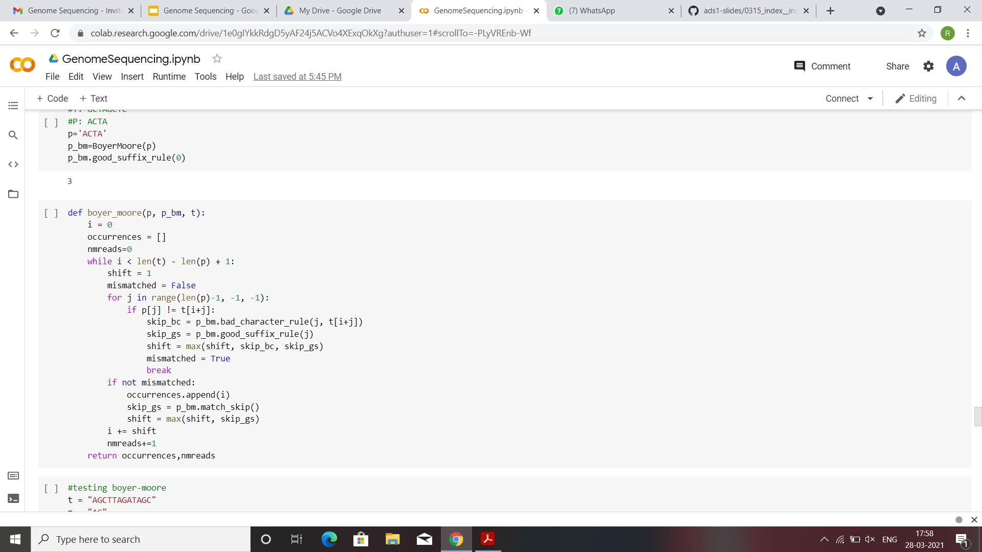
Boyer-Moore : Code Snippet
Notes:
Preprocessing matrix

Slide 26
Reference-free Reads Compression
This algorithm clusters the reads based on overlaps and similarity scores. For each cluster a consensus sequence is created which act as reference string to all other reads in cluster.
All the reads in the cluster are compressed using the consensus as the reference.
Two reads are said to be neighbors of each other if they have a large overlap (with a small Hamming distance in the overlapping region).
We find the neighbors of each read in steps 1 and 2 and use this neighborhood information to cluster the reads and perform compression.
In step 1 we find the potential neighbors of each read and in step 2 we find the neighbors of each read.

Slide 27
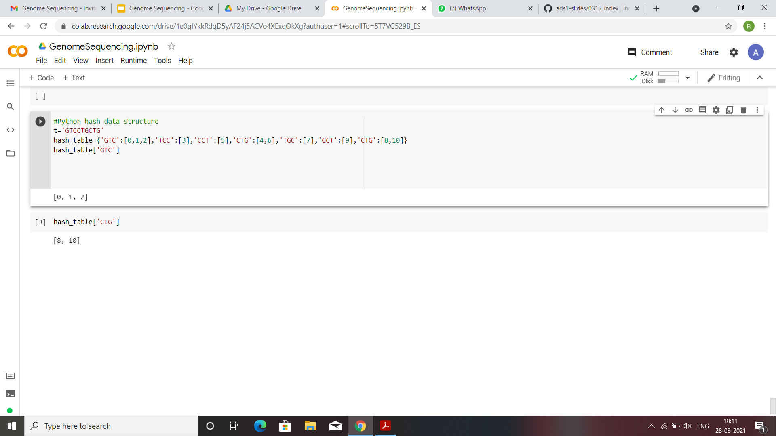
Reference-free Reads Compression

Slide 28
Quality Scores Compression
This score can be thought of as the probability that this base is correct.
At first we count the frequency of each character in the quality score sequences and identify the top m characters based on frequencies (where the value
of m is chosen to get the best compression).
Hamming distance is calculated for each quality score sequence s ,if distance is least let’s say between si and and s ,then si will serve as reference for all other s’s in sequence s.
S-quality score sequence-{s1,s2,s3………...sn}
Notes:
For each character, we whave m representative quality score sequences for each character c in quality score sequence.

Slide 29
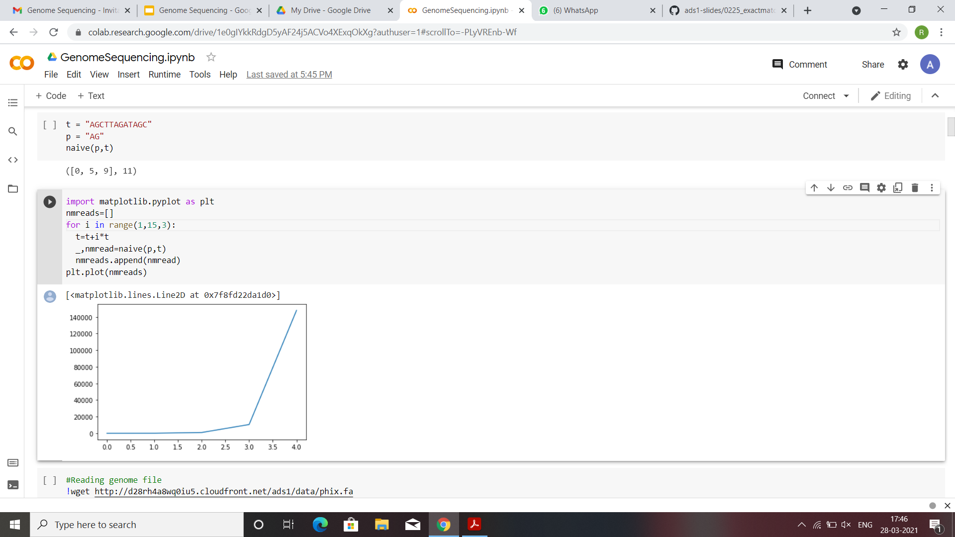
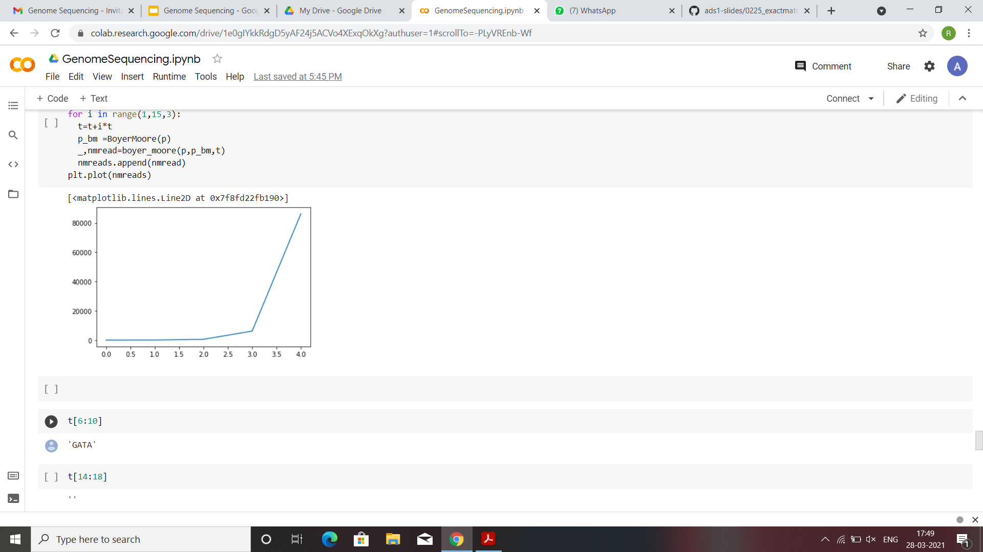
Preprocessing
How was Boyer-Moore algorithm different from Naive algorithm?
naive
Boyer-moore
Fig1 : Number of reads versus text size performance for naive
Fig2 :Number of reads versus text size performance for naive

Slide 30
Preprocessing
How was Boyer-Moore algorithm different from Naive algorithm?
The Boyer-Moore algorithm preprocesses the pattern P using a lookup table in order to use the the bad-character and good-suffix rule.

Slide 31
Preprocessing
How was Boyer-Moore algorithm different from Naive algorithm?
The Boyer-Moore algorithm preprocesses the pattern P using a lookup table in order to use the the bad-character and good-suffix rule.
Preprocessing : Naive algorithm
No preprocessing is done in Naive algorithm.
Naive Algo
P
Results
T

Slide 32
Preprocessing
How was Boyer-Moore algorithm different from Naive algorithm?
The Boyer-Moore algorithm preprocesses the pattern P using a lookup table in order to use the the bad-character and good-suffix rule.
Preprocessing : Boyer-Moore algorithm
Preprocessing in Boyer-Moore algorithm.
BM Algo
P
Results
Make lookup tables for bad character & good suffix rules
T
Notes:
Given pattern P I can preprocess the pattern P to create the lookup tables for bad character and good suffix rule and then, when text T is provided I can use the lookup tables to execute the text T. In Fact when we are matching same pattern with multiple texts T then we can use the preprocess data (lookup tables) of pattern P and we need not go through the pattern each time.

Slide 33
Preprocessing
What is the cost of preprocessing?

Slide 34
Preprocessing
What is the cost of preprocessing?
Preprocessing the data can be costly to do once but when the same data is executed multiple times it can be helpful.
Which is better ? Preprocessing the text or the pattern?

Slide 35
Preprocessing
What is the cost of preprocessing?
Preprocessing the data can be costly to do once but when the same data is executed multiple times it can be helpful.
Which is better ? Preprocessing the text or the pattern?
At first glance preprocessing the text might not seem a good idea because text files are generally big (very big) when compared to pattern P but this can be really useful when we are in a situation where we have to match the pattern to the text multiple times keeping the text file same. Various encoding techniques (compression techniques) can be used to encode the text file before-hand.
Algorithm that preprocesses ‘Text T’ is known as offline algorithm. Otherwise, algorithm is online.
Examples:
Naive Algorithm
Boyer-Moore Algorithm
Web Search Engine
Read Alignment Problem for Genome Sequence

Slide 36
Preprocessing
What is the cost of preprocessing?
Preprocessing the data can be costly to do once but when the same data is executed multiple times it can be helpful.
Which is better ? Preprocessing the text or the pattern?
At first glance preprocessing the text might not seem a good idea because text files are generally big (very big) when compared to pattern P but this can be really useful when we are in a situation where we have to match the pattern to the text multiple times keeping the text file same. Various encoding techniques (compression techniques) can be used to encode the text file before-hand.
Algorithm that preprocesses ‘Text T’ is known as offline algorithm. Otherwise, algorithm is online.
Examples:
Naive Algorithm : Online
Boyer-Moore Algorithm
Web Search Engine
Read Alignment Problem for Genome Sequence

Slide 37
Preprocessing
What is the cost of preprocessing?
Preprocessing the data can be costly to do once but when the same data is executed multiple times it can be helpful.
Which is better ? Preprocessing the text or the pattern?
At first glance preprocessing the text might not seem a good idea because text files are generally big (very big) when compared to pattern P but this can be really useful when we are in a situation where we have to match the pattern to the text multiple times keeping the text file same. Various encoding techniques (compression techniques) can be used to encode the text file before-hand.
Algorithm that preprocesses ‘Text T’ is known as offline algorithm. Otherwise, algorithm is online.
Examples:
Naive Algorithm : Online
Boyer-Moore Algorithm : Online
Web Search Engine
Read Alignment Problem for Genome Sequence

Slide 38
Preprocessing
What is the cost of preprocessing?
Preprocessing the data can be costly to do once but when the same data is executed multiple times it can be helpful.
Which is better ? Preprocessing the text or the pattern?
At first glance preprocessing the text might not seem a good idea because text files are generally big (very big) when compared to pattern P but this can be really useful when we are in a situation where we have to match the pattern to the text multiple times keeping the text file same. Various encoding techniques (compression techniques) can be used to encode the text file before-hand.
Algorithm that preprocesses ‘Text T’ is known as offline algorithm. Otherwise, algorithm is online.
Examples:
Naive Algorithm : Online
Boyer-Moore Algorithm : Online
Web Search Engine : Offline
Read Alignment Problem for Genome Sequence
Notes:
Web search engine is offline algo because the text T is enormous because it is the entire world wide web. So if Web search engine did not preprocess the the WWW in some way each search would require the search engine to search entire WWW and it would take enormous time !

Slide 39
Preprocessing
What is the cost of preprocessing?
Preprocessing the data can be costly to do once but when the same data is executed multiple times it can be helpful.
Which is better ? Preprocessing the text or the pattern?
At first glance preprocessing the text might not seem a good idea because text files are generally big (very big) when compared to pattern P but this can be really useful when we are in a situation where we have to match the pattern to the text multiple times keeping the text file same. Various encoding techniques (compression techniques) can be used to encode the text file before-hand.
Algorithm that preprocesses ‘Text T’ is known as offline algorithm. Otherwise, algorithm is online.
Examples:
Naive Algorithm : Online
Boyer-Moore Algorithm : Online
Web Search Engine : Offline
Read Alignment Problem for Genome Sequence : Offline (text T does not change)

Slide 40
Indexing and k-mer indexes
Target Problem (Read Alignment Problem): Large collection of read collections are to be matched with the genome sequence (text ‘T’) .

Slide 41
Indexing and k-mer indexes
Target Problem (Read Alignment Problem): Large collection of read collections are to be matched with the genome sequence (text ‘T’) .
We know that genome sequence is similar across the individuals of same species and hence it might be good to preprocess the genome sequence and come up with compression algorithm which can help the matching of read collections to the genome sequence.

Slide 42
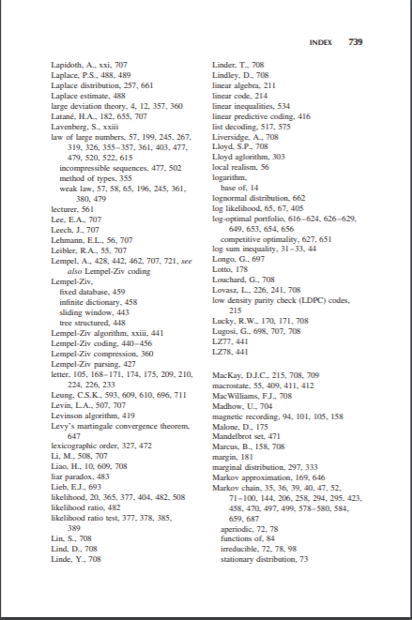
Indexing (Textbook Analogy)
Source: Thomas M. Cover Text
Markov Chains
Notes:
One of the nice analogy is indexing a book. This is an excerpt from Thomas M Cover book, here index is a list of key terms which consists of terms which occur in the text and its index is where more information of this term may be found in the book. This process is known is querying.
So in this example we can first locate Markov Chains in the index because the index is sorted in alphabetical order and then we can query the index to get more information.

Slide 43
Indexing DNA
Index of T
C G T G C : 0
T : C G T G C G T G C T T
Notes:
So the algorithm which we will implement to create the Index of the DNA will similar to the index of the book. We can then break the text T into words and use them to index the file. One of the way is considering substrings as words.

Slide 44
Indexing DNA
Index of T
C G T G C : 0
G T G C G : 1
T : C G T G C G T G C T T

Slide 45
Indexing DNA
Index of T
C G T G C : 0
G T G C G : 1
T G C G T : 2
T : C G T G C G T G C T T

Slide 46
Indexing DNA
Index of T
C G T G C : 0
G C G T G : 3
G T G C G : 1
T G C G T : 2
T : C G T G C G T G C T T
Notes:
This index is added to maintain the alphabetical order.

Slide 47
Indexing DNA
New offset
Index of T
C G T G C : 0 , 4
G C G T G : 3
G T G C G : 1
T G C G T : 2
T : C G T G C G T G C T T
Notes:
Since this substring is already present in the index we add the offset it to the corresponding index value.

Slide 48
Indexing DNA
Index of T
C G T G C : 0 , 4
G C G T G : 3
G T G C G : 1
G T G C T : 5
T G C G T : 2
T G C T T : 6
5-mer index
T : C G T G C G T G C T T
Notes:
Index after adding all the substrings of length 5. We denote the substrings of length 5 as 5-mer. Similarly substrings of length k will be referred to as k-mer.

Slide 49
Querying the index
Index of T
C G T G C : 0 , 4
G C G T G : 3
G T G C G : 1
G T G C T : 5
T G C G T : 2
T G C T T : 6
5-mer index
T : C G T G C G T G C T T
P: G C G T G C
Notes:
Say we have a pattern string P. We first look at the 5-mer of P and then see where has it occurred in T.

Slide 50
Querying the index
Index of T
C G T G C : 0 , 4
G C G T G : 3
G T G C G : 1
G T G C T : 5
T G C G T : 2
T G C T T : 6
5-mer index
T : C G T G C G T G C T T
P: G C G T G C
Notes:
Looking at the substrings we see that we have match and thus we can find this 5-mer in text T starting at offset 3.
But we are not done yet. We are not sure whether rest of the characters in P match text T. Then next step is to find whether the neighbours of the match the text T. This step is know as verification.

Slide 51
Querying the index
Index of T
C G T G C : 0 , 4
G C G T G : 3
G T G C G : 1
G T G C T : 5
T G C G T : 2
T G C T T : 6
5-mer index
T : C G T G C G T G C T T
P: G C G T G C
Notes:
Let us consider the case when second 5-mer of P is considered.

Slide 52
Querying the index
Index of T
C G T G C : 0 , 4
G C G T G : 3
G T G C G : 1
G T G C T : 5
T G C G T : 2
T G C T T : 6
5-mer index
T : C G T G C G T G C T T
P: G C G T G C
Notes:
Here we see that there are two index hits at offsets 0 and 4.
In the verification step we see that there is no character to the left of the first 5-mer at offset 0 in text T and hence the neighbours do not match. Whereas the neighbour of the second 5-mer matches to the neighbour of the pattern P and hence P is found in T!

Slide 53
Querying the index
Index of T
C G T G C : 0 , 4
G C G T G : 3
G T G C G : 1
G T G C T : 5
T G C G T : 2
T G C T T : 6
5-mer index
T : C G T G C G T G C T T
P: G C G T G C
Notes:
Here we see that there are two index hits at offsets 0 and 4.
In the verification step we see that there is no character to the left of the first 5-mer at offset 0 in text T and hence the neighbours do not match. Whereas the neighbour of the second 5-mer matches to the neighbour of the pattern P and hence P is found in T!

Slide 54
k-Mer Matching of the Index
After dividing and encoding (preprocessing) the entire text into multiple k-mers and storing them in the index, how do we find the substring of pattern P in the index?
Notes:
One of the way is to go through the entire index one by one and stop once we have a match. But as the k-mer size decreases and size of text file increase the index file can be considerably large. Going through the index file one by one can be a huge computational loss.
Instead we can utilize the fact that index file is alphabetically sorted and hence binary search algorithm can be used very efficiently.

Slide 55
k-Mer Matching of the Index
Binary Search:
T : G T G C G T G G G G G
P: G C G T G G
create the index file.

Slide 56
Binary Search
C G T | 3
G C G | 2
G G G | 8
G G G | 9
G G G | 10
G T G | 0
G T G | 4
G T G | 6
T G C | 1
T G G | 7
T G T | 5
Binary Search:
T : G T G C G T G G G G G
P: G C G T G G
Notes:
Compare T G G to the 3 mer which is in the middle of the index file.
T G G > G T G

Slide 57
Binary Search
C G T | 3
G C G | 2
G G G | 8
G G G | 9
G G G | 10
G T G | 0
G T G | 4
G T G | 6
T G C | 1
T G G | 7
T G T | 5
After first bisection
Binary Search:
T : G T G C G T G G G G G
P: G C G T G G
Notes:
T G G > T G C

Slide 58
Binary Search
C G T | 3
G C G | 2
G G G | 8
G G G | 9
G G G | 10
G T G | 0
G T G | 4
G T G | 6
T G C | 1
T G G | 7
T G T | 5
After second bisection
Binary Search:
T : G T G C G T G G G G G
P: G C G T G G
Match at offset 7
Notes:
T G G = T G G

Slide 59
Binary Search
This algorithm is very useful in k-mer matching of index because the index file is sorted alphabetically.
Time Complexity: Let’s assume the worst case where the match occurs at last bisection and so O(log(n))
Python command : bisect_left(index table, k-mer)

Slide 60
Conclusion
Exploration of data structure algorithms are used for analyzing DNA sequencing data.
Algorithms are used for overcoming read alignment problem
Various algorithms are used to encode and sequence genome data.
Naive algorithm and Boyer-Moore algorithm is studied for reference based DNA sequencing and their performance is compared.
Implementation of matching algorithm is done in python.
Offline algorithm for encoding and compressing the genome file is studied.
Compression techniques of FASTQ file format is studied.
Reference free Read compression
Meta data compression

